Slide 1
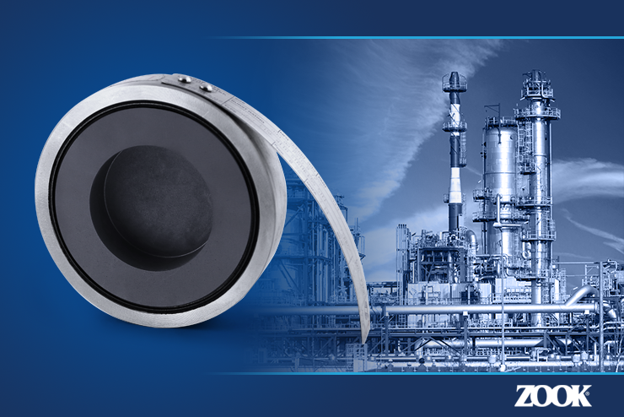
Social Media Image – Right Click to Save Image on Desktop
Suggested Text:
Mono Type Graphite Rupture Disks are the best choice for low and intermediate burst ratings (burst ratings 0.25 to 150 psig). They are designed to fit industry standard flanges ASME B16.5, ISO and JIS. #Graphite #RuptureDisk #ZOOK
Can include product page link: https://zookdisk.com/products/mono/
Visit us at www.zookdisk.com
SERVING AMERICA, CENTRAL & SOUTH AMERICA 16809 Park Circle Drive Chagrin Falls, Ohio 44022 United States Toll Free: +1 800 543 1043 Phone: +1 440 543 1010 Fax: +1 440 543 4930 E-mail: sales@zookdisk.com | SERVING EUROPE, MIDDLE EAST & AFRICA Navigation House, Bridge St. Killamarsh, Sheffield, S21 1AL United Kingdom Phone: +44 (0) 1909 560999 Fax: +44 (0) 1909 560860 E-mail: sales.europe@zookdisk.com | SERVING CANADA 4400 South Service Road Burlington, Ontario, L7L 5R8 Canada Toll Free: +1 800 370 6057 Phone: +1 905 681 2885 Fax: +1 905 681 8838 E-mail: sales.canada@zookdisk.com | SERVING ASIA PACIFIC Unit No. 23A-05, Menara Landmark No.12, Jalan Ngee Heng 80000 Johor Bahru, Johor, Malaysia Phone: +60 (7) 2910099 Fax: +60 (7) 2910096 E-mail: sales.asia@zookdisk.com

