Slide 1
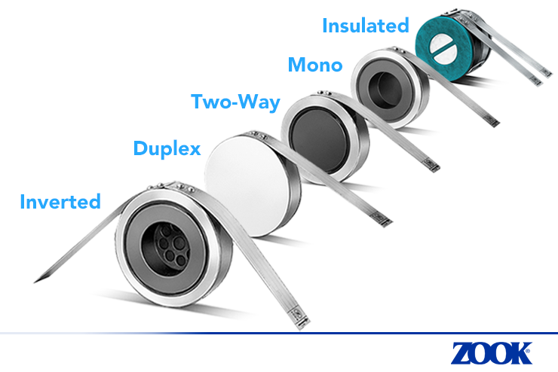
Social Media Image – Right Click to Save Image on Desktop
Suggested Text:
Did You Know? … ZOOK's Graphite Division is the first and largest Graphite company in the world committed to manufacturing quality impervious graphite Rupture Disks. #Graphite #RuptureDisk #DidYouKnow
https://zookdisk.com/product-solutions/graphite-disks/
Visit us at www.zookdisk.com
SERVING AMERICA, CENTRAL & SOUTH AMERICA 16809 Park Circle Drive Chagrin Falls, Ohio 44022 United States Toll Free: +1 800 543 1043 Phone: +1 440 543 1010 Fax: +1 440 543 4930 E-mail: sales@zookdisk.com | SERVING EUROPE, MIDDLE EAST & AFRICA Navigation House, Bridge St. Killamarsh, Sheffield, S21 1AL United Kingdom Phone: +44 (0) 1909 560999 Fax: +44 (0) 1909 560860 E-mail: sales.europe@zookdisk.com | SERVING CANADA 4400 South Service Road Burlington, Ontario, L7L 5R8 Canada Toll Free: +1 800 370 6057 Phone: +1 905 681 2885 Fax: +1 905 681 8838 E-mail: sales.canada@zookdisk.com | SERVING ASIA PACIFIC Unit No. 23A-05, Menara Landmark No.12, Jalan Ngee Heng 80000 Johor Bahru, Johor, Malaysia Phone: +60 (7) 2910099 Fax: +60 (7) 2910096 E-mail: sales.asia@zookdisk.com

